Slide 1
Educator Effectiveness
Digging into Domain 4

Slide 2
Educator Effectiveness in PA
PDE has been working since 2010 to develop an educator effectiveness model that will incorporate those attributes that are most critical to the way teachers, non-teaching professionals, and principals are evaluated as well as providing training tools for professional growth that provide support as part of a fair effective evaluation process.

Slide 3
ACT 82 Defined
The new rating system is required for all school districts, intermediate units and area vocational-technical schools.
• 2013-2014 Classroom Teachers
• 2014-15 Principals
• 2014-15 professional employees who are education specialists or who provide services other than classroom instruction [nonteaching professional employees].

Slide 4
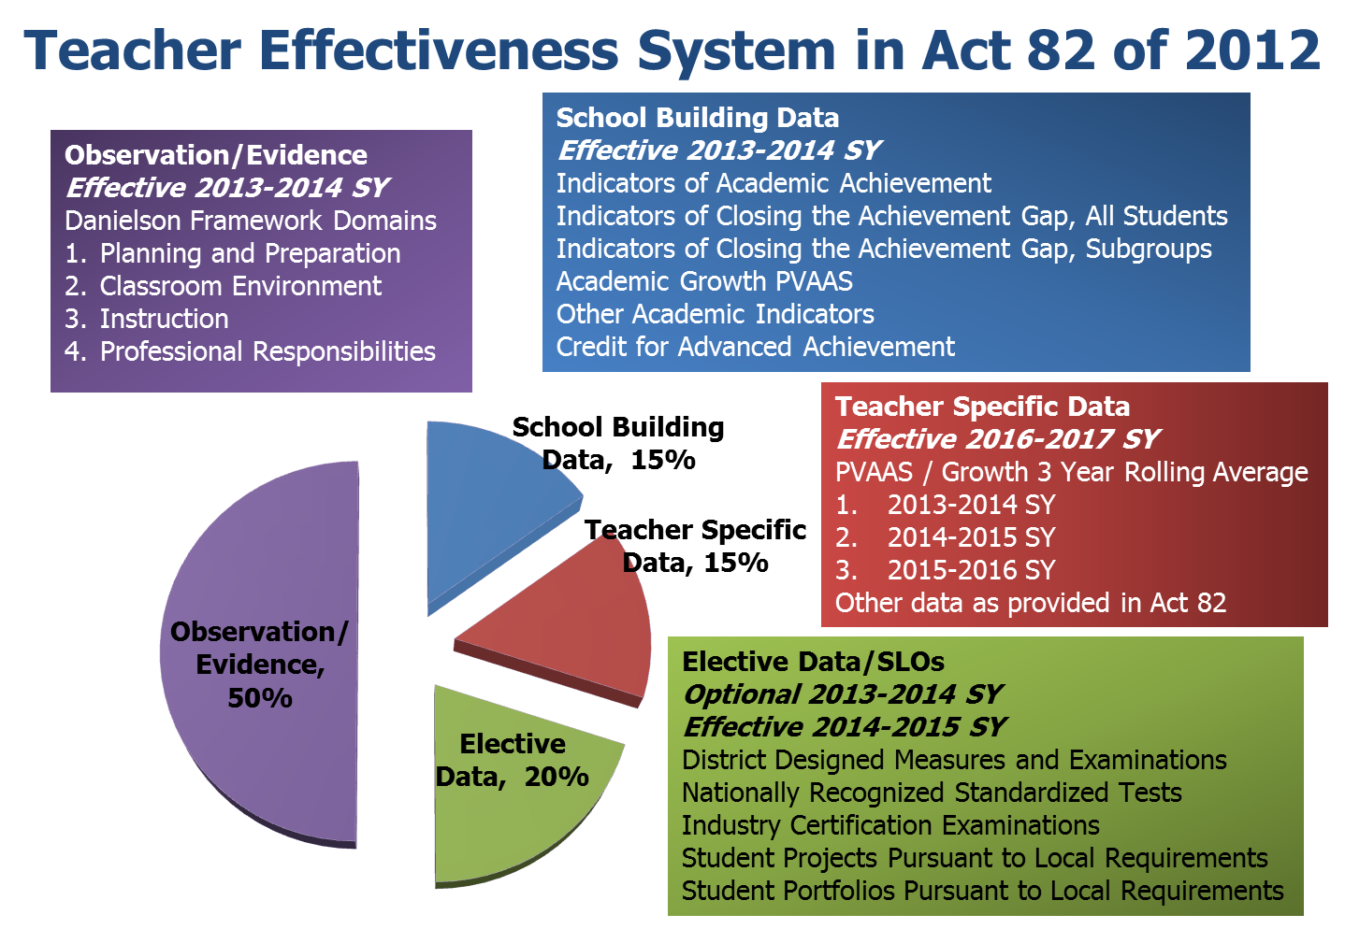
Instructional Certificate

Slide 5
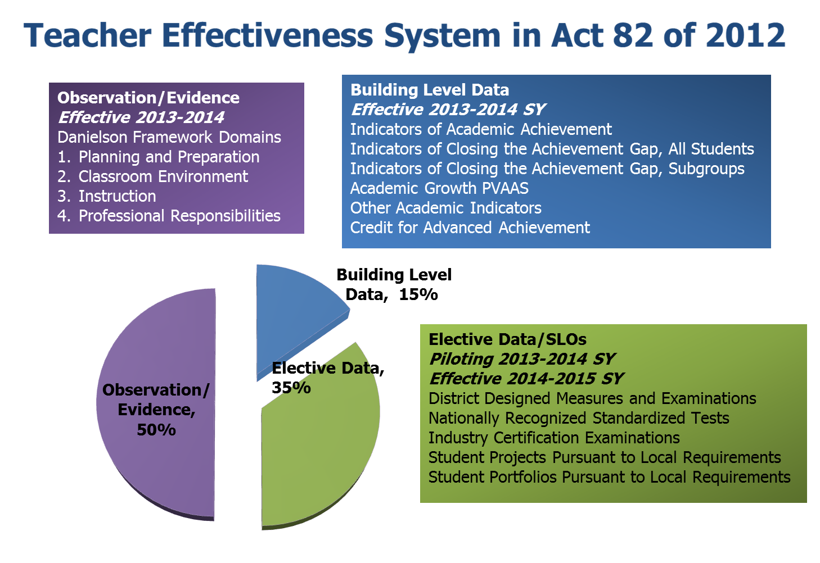
Instructional Certificate
* Non-Tested Grade Levels, and Subjects Areas

Slide 6
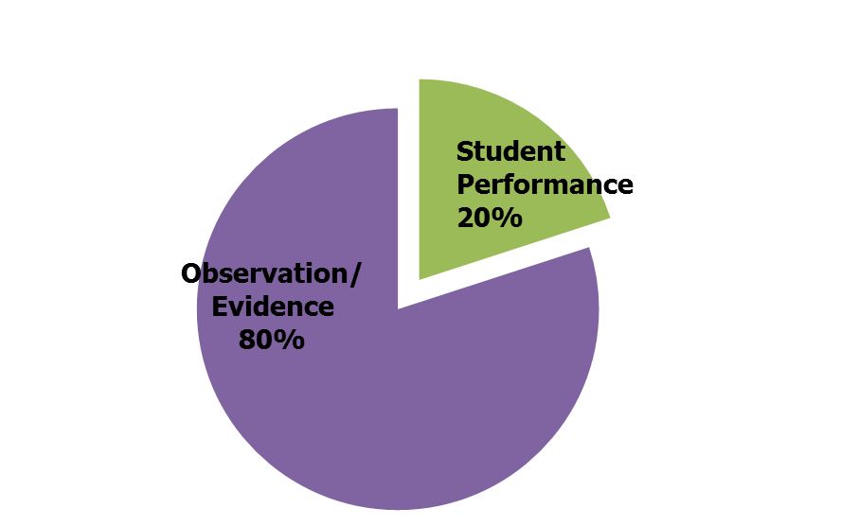
Specialist/
Licensed Professional
Non Teaching Professional Employee
Effectiveness System in Act 82 of 2012
Effective 2014-2015 SY
Observation/Evidence
Danielson Framework Domains
Planning and Preparation
Educational Environment
Delivery of Service
Professional Development
Student Performance of All Students in the School Building in which the Nonteaching Professional Employee is Employed
District Designed Measures and Examinations
Nationally Recognized Standardized Tests
Industry Certification Examinations
Student Projects Pursuant to Local Requirements
Student Portfolios Pursuant to Local Requirements

Slide 7
Classroom Teacher Phase In Percentages
Year Observation Building Score Teacher Specific Elective Data
2013-14 85% 15% N/A N/A
2013-14 50% 15% N/A 35% pilot
2014-15 50% 15% N/A 35%
2015-16 with PVAAS 50% 15% 15% 20%
2015-16 without PVAAS 50% 15% N/A 35%

Slide 8

Formative Supervision Framework for Teaching
The Pennsylvania Department of Education is recommending a supervision system consisting of two models:
Formal Observation/Clinical Model
Differentiated Supervision.

Slide 9
Differentiated Supervision
Recognizes the level of experience, the effectiveness, and professionalism of teachers as well as the intensity and time commitment to Formal Observation.
Professional employees will develop an action plan for professional development unique to their needs and interests.

Slide 10
Eligibility to Participate in Differentiated Supervision
PDE recommends that professional employees who have received a Satisfactory summative rating in the previous two years should be eligible to participate in Differentiated Supervision.
Prior to the 2013-2014 school year, a Satisfactory performance rating using a previously approved rating form, e.g., PDE 5501, PDE 426, PDE 427, or PDE 428 may be used to qualify for participation in Differentiated Supervision.
All Differentiated Supervision Modes must be aligned to the Danielson’s Framework for Teaching or a PDE approved alternative system and/or related to a district or school initiative designed to improve instructional practices and impact student achievement.

Slide 11

Differentiated Supervision Modes
Peer Coaching Mode
Self Directed Model/Action Research
Portfolios

Slide 12
Peer Coaching Mode
Professional employees work in dyads or triads to discuss and observe their own or another professional employee's pedagogy, student learning, curriculum aligned to the Pennsylvania Core Standards and other pertinent issues in a collaborative manner.
The professionals will work together to define their professional needs and develop plans to assist them in the successful completion of the identified tasks including: specific target area(s), the evidence to be collected, observation dates, and a reflective session.
Meeting notes, data collection tools, results of the observations, and the reflective sessions should be shared with the principal and used as evidence in the supervision and evaluation of the employee.

Slide 13
Self Directed Model Action Research
Professional employees will develop a structured, on-going reflection of a practice-related issue (Danielson’s Framework for Teaching or a PDE approved alternative system).
Professionals may work individually or in small groups, dyads or triads, to complete the action research project.
Meeting notes, resources, data collection tools, and the results of the reflective sessions should be shared with the principal and used as evidence in the supervision and evaluation of the employee.

Slide 14
Portfolios
Professional employees will examine their own practice in relation to the Danielson’s Framework for Teaching or a PDE approved alternative system and reflect in a written report and/or documented discussions with colleagues.
Portfolios may be developed according to criteria established collaboratively by the administrator and the teacher based upon their interests or needs.
Resources, data collection tools, and the results of the reflective sessions should be shared with the principal and used as evidence in the supervision and evaluation of the employee.

Slide 15

What is a Portfolio?
Zepeda says, “An organized, goal-driven documentation of your professional growth and achieved competence in the complex act called teaching.” (Zepeda, 2012 pg. 275)
Doolittle says, “A teacher portfolio is a document created by the teacher that reveals, relates, and describes the teacher’s duties, expertise and growth in teaching.” (Doolittle, 1994 pg. 1)

Slide 16
The Contents of a Portfolio
    Personal (e.g., statement of beliefs concerning teaching)
    Curricular (e.g., sample lesson plans and tests)
    Classroom (e.g., samples of student work)
    School as learning community (e.g., committee work, interdisciplinary lesson artifacts)
    Professional growth (e.g., career goals, journals, videotapes) (Zepeda and Mayers 2000, pg. 168)

Slide 17

Portfolio Supervision
A Model of Portfolio Supervision
  Essential Skills of Portfolio Supervision
    Reflection
    Goal Setting
    Self-analysis
    Decision Making

Slide 18

Teacher Growth and Portfolios
“How do Portfolios benefit teacher growth?”

Slide 19

Authenticate Learning
Portfolios prove a connection to the contexts and personal histories that characterize real teaching and make it possible to document the unfolding of both teaching and learning over time.

Slide 20
Accountability
As the era of accountability moves forward, what teachers do day to day and the gains of learning need to be documented. The teacher is in the best position to showcase their talents, successes and works in progress. This progress for both students and teachers cannot be measured solely through standardized assignments.

Slide 21
Supervisory Aspects
Portfolio supervision supports the ongoing study of the teaching process by the individual teacher, alone, or with collegial or supervisory support.
Create conditions to examine practice and do some action research.
Pinpoint needed professional development.
Assess the impact of professional development activities.

Slide 22
Collaborative Growth
Portfolios exhibit growth when we find time to be sure we are working on them, consulting with others, and reflecting on the meaning of the portfolio and its artifacts.
Portfolios foster collaboration between professionals as they discuss and share their contents.

Slide 23
Reflection
Portfolios chronicle professional growth; they are an authentic way for teachers to reflect on their impact on student learning while assessing their own performance.

Slide 24

Goal Setting
Helps with the attainment of short term and long term goals.
It reveals, relates, and describes the teacher’s duties. Expertise and growth in teaching.

Slide 25
Future Decisions
The portfolio is a product. What is done with them after they are examined will decide what changes in practice should occur the following year.
Portfolios guide decision making and thinking and this in turn signals growth and development.
They should be used to refine goals and target activities to accomplish goals

Slide 26

In Conclusion….
Portfolios are a great way to improve professional practice and reflect on your teaching.
Portfolios are a way to represent your work in the classroom and can enhance the New Teachers Evaluation Process.

Slide 27
Portfolio Planning
3 Levels of Preparation Involving Technology

Slide 28
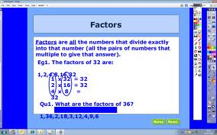

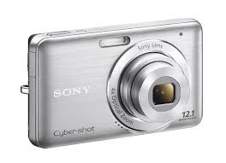
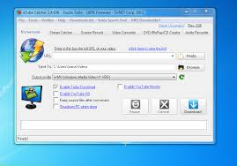

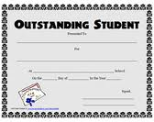

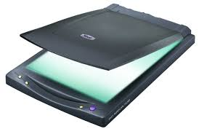
Collecting artifacts

Slide 29





Digital (Electronic) Portfolios
PDF Portfolio
Presentation Style
Webpage

Slide 30
Samples for Inspiration
Weebly Teaching Portfolio
Sitemaker Portfolio
Prezi Example
Word Template
Acrobat Portoflio
Another Weebly
Yola Portfolio

Slide 31

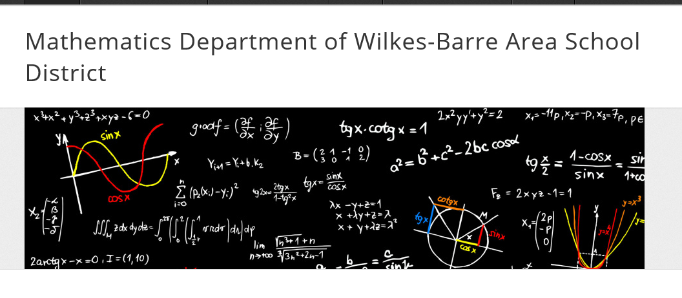
Resources for You

Slide 32
Additional Resources
Teaching Portfolio Resources
Guidelines for Creating Portfolios

Slide 33
Standards Aligned System
SAS
Teachscape

Slide 34

Questions

Slide 35
References..
http://www.vcu.edu/cte/resources/nfrg/DevelopingaTeachingPortfolio.pdf
https://cndls.georgetown.edu/media/documents/teachingportfolio.pdf

